Slide 1
Comprehensive Development Project
Game Ideas

Slide 2


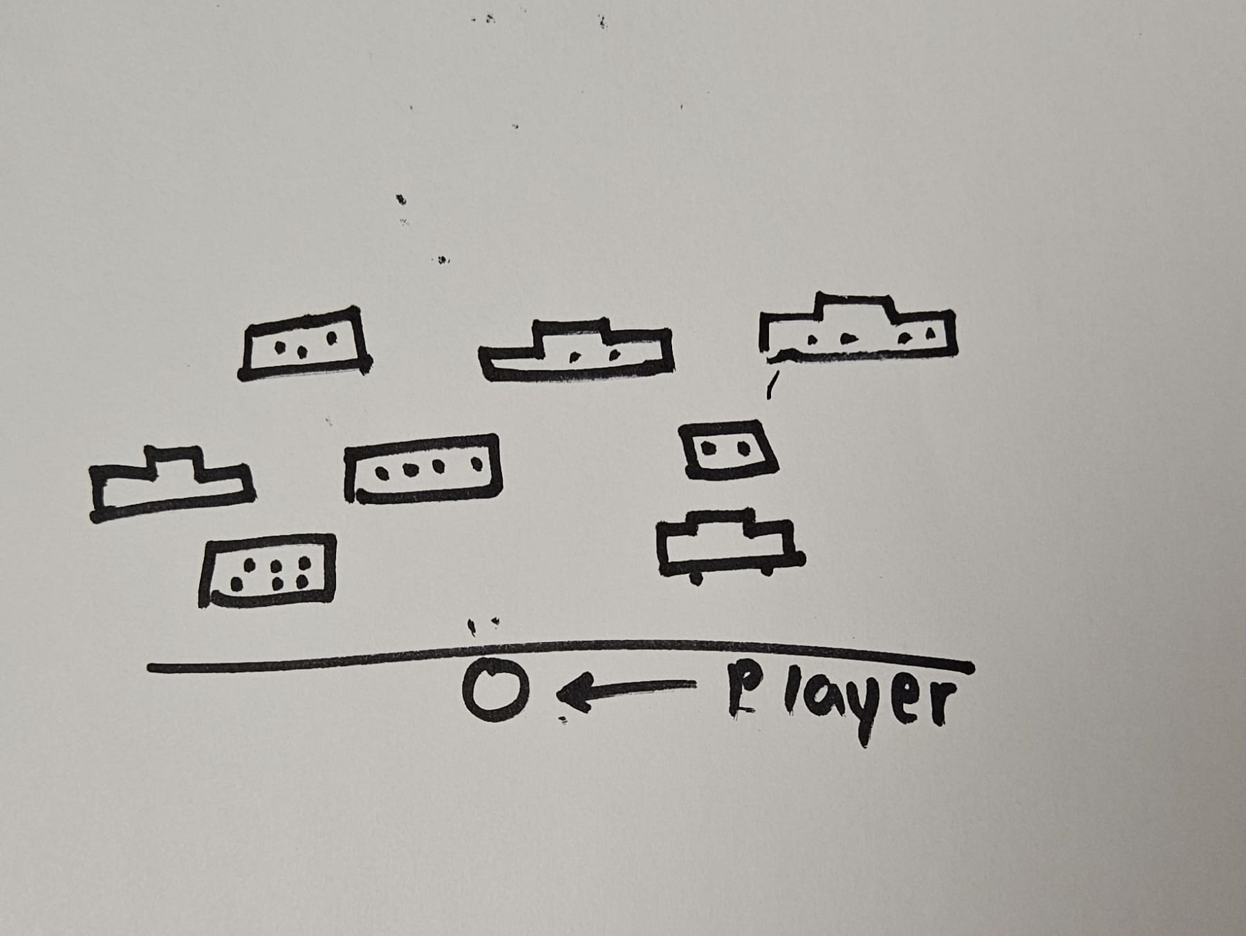

Go Safe
Player can move in four directions.
Player have to cross the road, safely from the obstacles like cars and trucks on the road.
He can only have 3 lives.
Player can collect coins and powerups that helps to cross road faster and safely.
Genre: Arcade Action Game

Slide 3
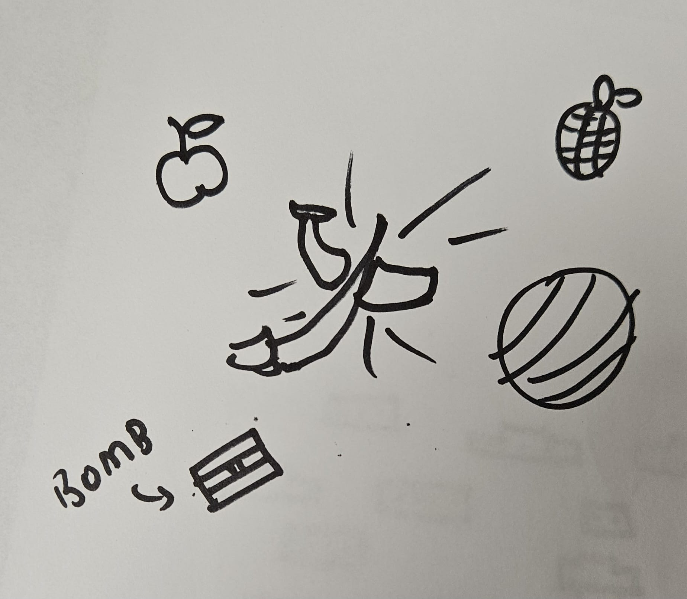
Fruit Saga
In this game, player is knife, he has to cut all the fruits in order to win.
Genre: Action Game
In between there might be some bombs, and that can kill player if he tries to cut it.

Slide 4
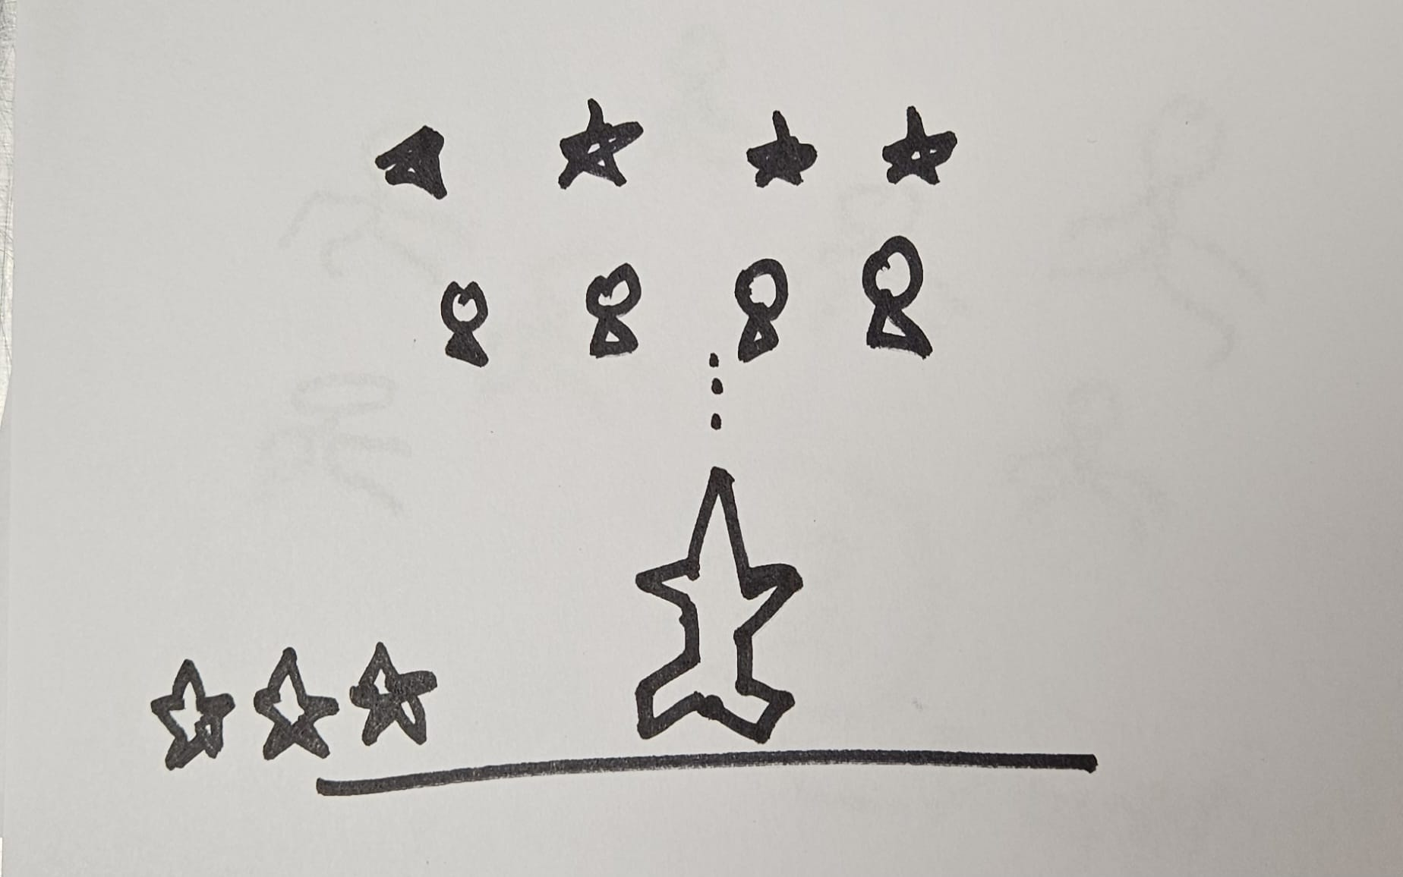
Space Invaders
A plane game where a player have to shoot down aliens and move forward avoiding collision with them.
Genre: Action Shooter Game
In each game player has 3 lives and player cancollect powerups that help in killing enemies faster.

Slide 5
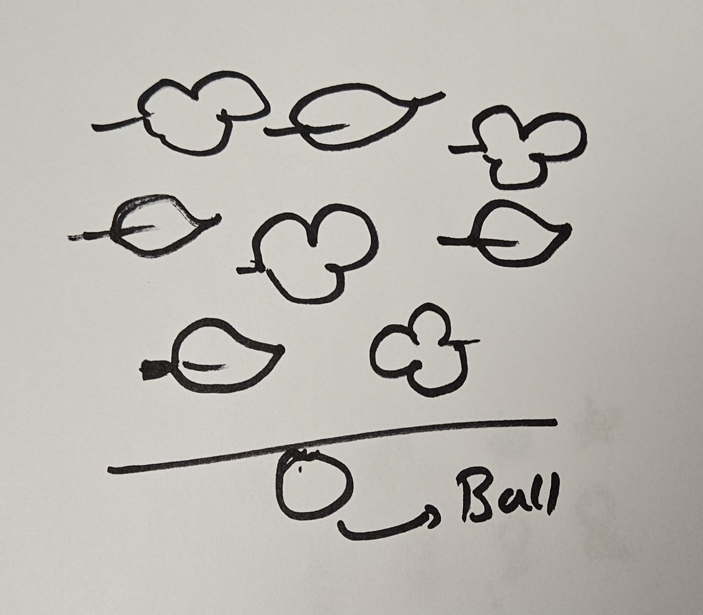
Ball Bounce
In this game, a player have to bounce on the ball on the leaves, and avoid getting into the water.
Arcade Game
Leaves moves towards a direction and ball have to bounce to next leaves in order to move forward.

Slide 6
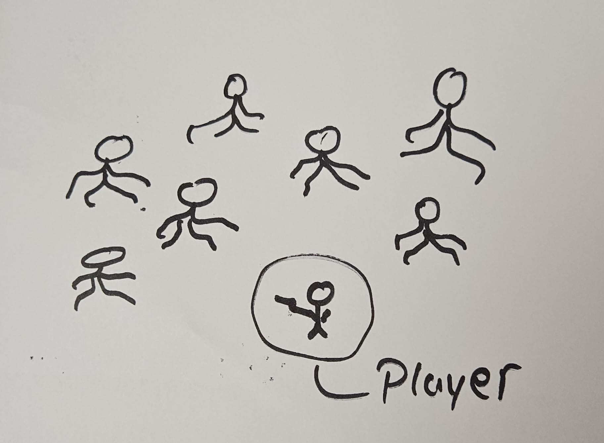
Zombie Invaders
In this game, zombies attack player from all direction, and player have to shoot down the zombies. With increase in kill numbers, the amount of zombies increases, increasing the difficulty.
Genre: Survival Horror Game

Slide 7
AND MANY MORE IDEAS…
THANK YOU!!

